Slide 1
Using Business Case Methods to improve rail projects
July 12, 2020

Slide 2
Agenda
1
My Background
2
Why Business Planning Matters – UK Experience
3
Toronto GO Expansion
4
Relevance to US Cities

Slide 3
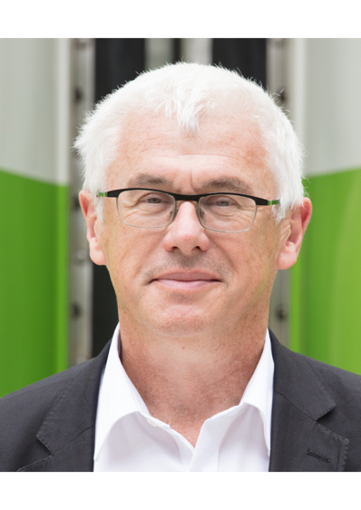
Experience in Canada, USA, UK, Germany, Australia, Nigeria…
Toronto native; 1981 Harvard Kennedy School; internship UMTA (FTA)
1981 – 1983 Vancouver Skytrain – Design Coordinator
1983 – 1986 UTDC (Bombardier) International Business Development
1986 – 1988 Honolulu Rapid Transit – Chief Planner
1988 – 1992 London Canary Wharf – (Jubilee Line, Docklands Light Railway)
1992 – 1996 UK Channel Tunnel Rail Link (High Speed 1)
1994 – 2003 UK rail privatization; GB Railways, Anglia Intercity, Hull Trains
1999 – 2001 Australia transit privatization; Great Southern Railway
1999 – 2007 GB Railfreight, UK
2003 – 2008 Germany bus and rail competitive tendering
2008 – 2014 Lagos Blue Line (Metro)
2008 – 2012 Germany Hamburg Cologne Express
2012 – Canada VIA Rail High Speed
2012 – Toronto NEPTIS report
2013 – Toronto GO Regional Express Rail – GO Expansion – ongoing
2016 – CHSRA Business Plan review
2017 – Caltrain Business Plan development - ongoing
2018 – Toronto Subways expansion – Strategy and Challenge - ongoing

Slide 4
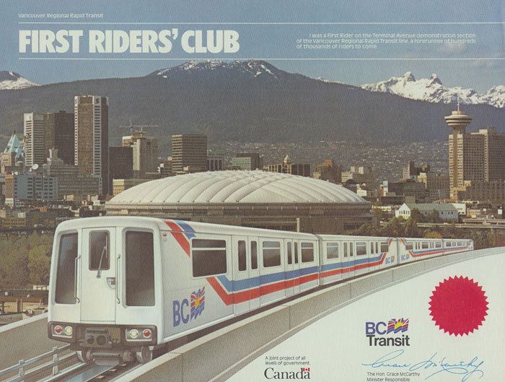
Vancouver Skytrain – Automated Metro

Slide 5
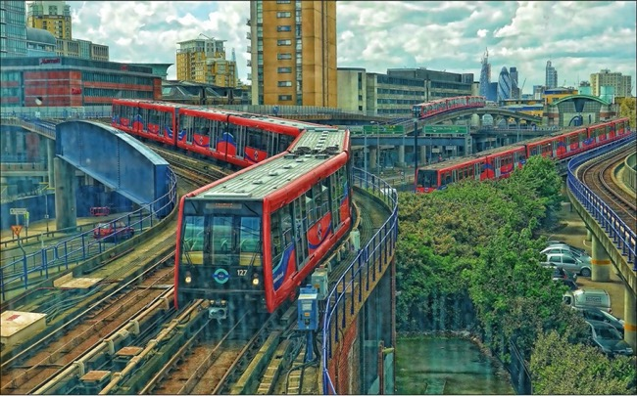
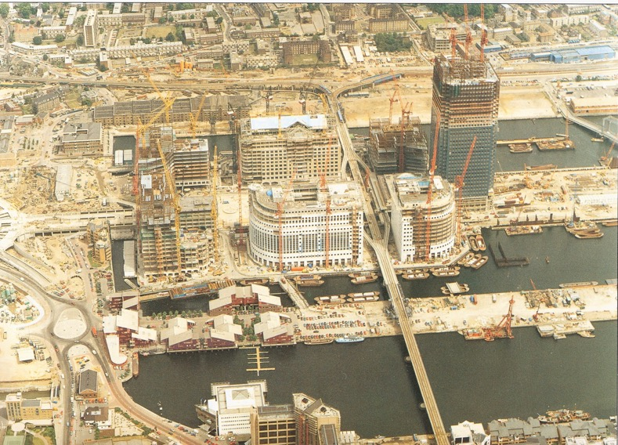
London Canary Wharf – Automated Metro

Slide 6
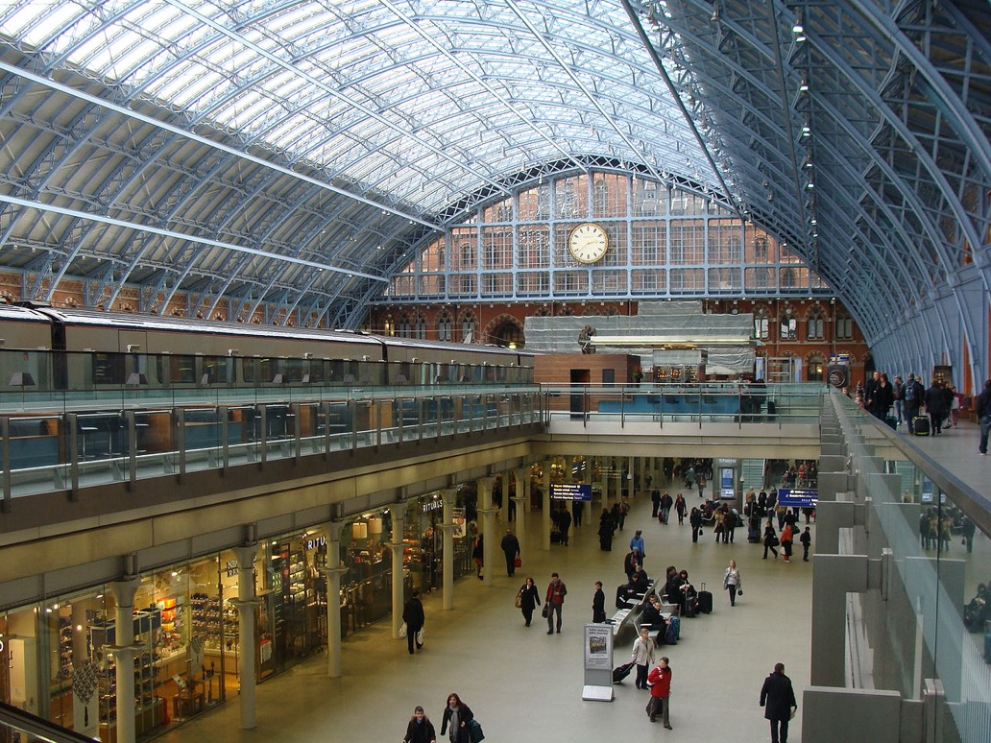
Channel Tunnel Rail Link (High Speed 1) and St Pancras Station

Slide 7
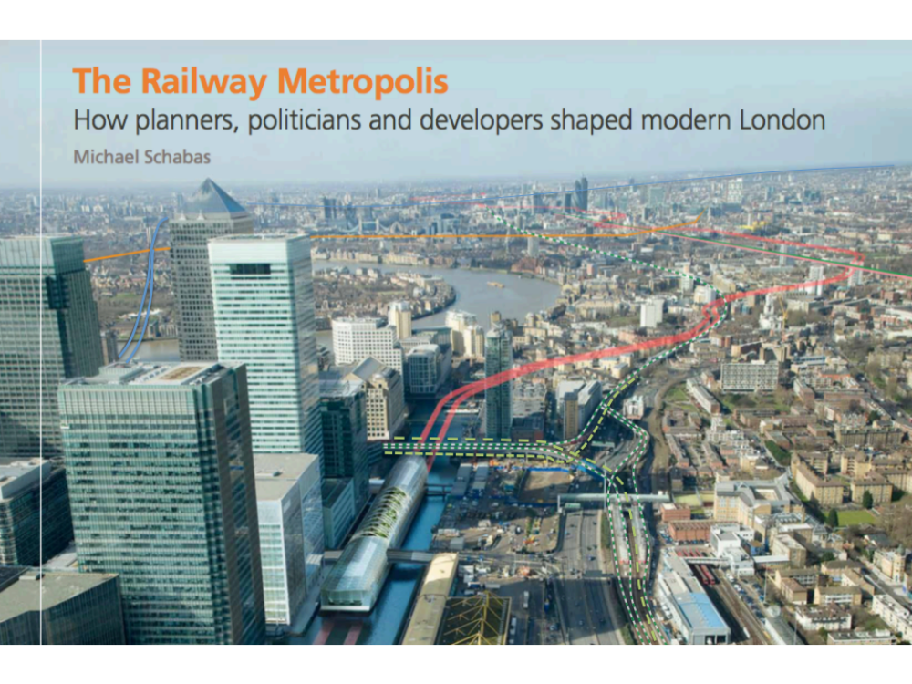
The Railway Metropolis

Slide 8
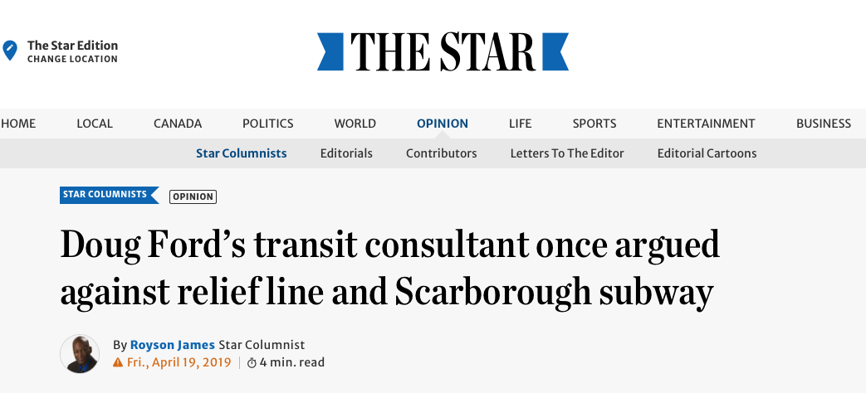
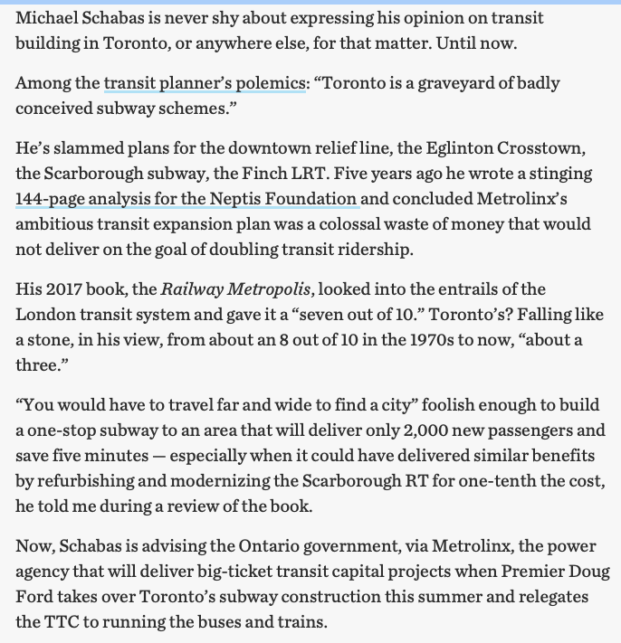

Slide 9
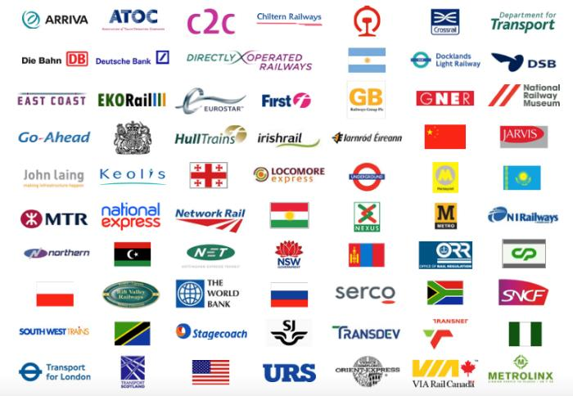
Partner in FCP which supports “all sides” of the rail industry

Slide 10
Agenda
1
My Background
2
Why Business Planning Matters – UK Experience
3
Toronto GO Expansion
4
Relevance to US Cities

Slide 11
Why Business Planning Matters
Railways are complex multi-billion dollar businesses
If they are designed by “feel”, or politics, they almost always lose money and often fail to achieve benefits even remotely approaching costs
With careful analysis, it is sometimes possible to identify schemes that are worthwhile in economic terms, taking account of transport benefits
In the right corridor, rail schemes can even make financial sense, sometimes paying back capital
It is a myth that passenger rail in the US loses money entirely because of subsidies to other modes.

Slide 12
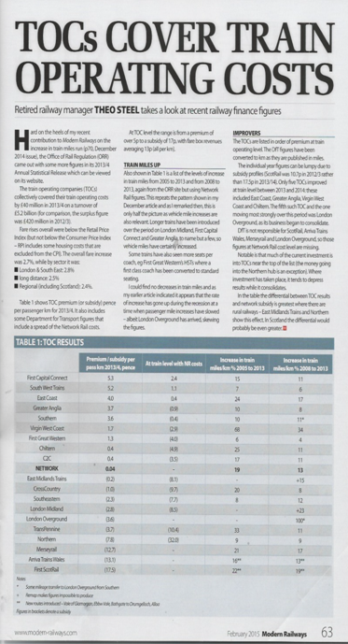
Can a railway really cover its costs?
Most operators do not provide transparent accounts
“Profitability” often buried within combined bus/rail businesses (like GO) and with cross-subsidy between lines
Care needed to distinguish capex, depreciation, renewals, enhancements, financial charges
Fares often depressed for policy reasons; working practices may also be inefficient
UK Rail Regulator provides detailed information for UK Train Operating Companies and Network Rail
Most UK TOCs now cover operating costs
NJ Transit admits that NE Corridor commuter rail “covers its costs”

Slide 13
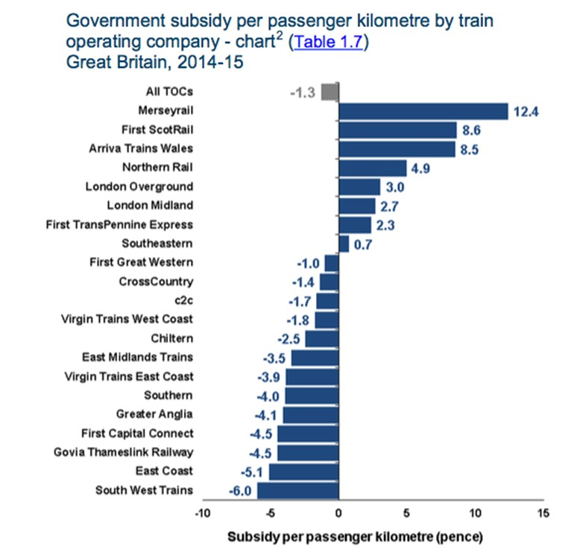
Most UK passenger rail operators now recover their full costs including capital renewals from fares

Slide 14
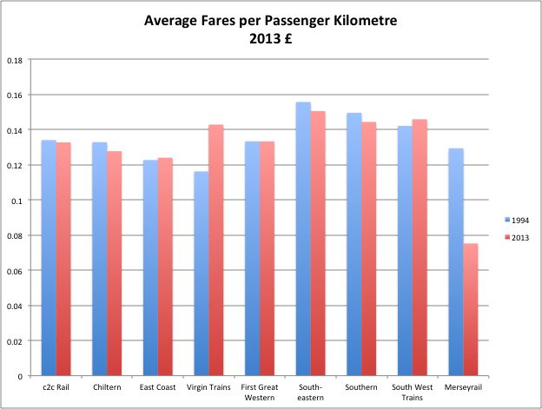
Since UK rail privatization, average fares have remained constant in real terms
Average fares have remained broadly constant, while quality (comfort, speed, frequency) has improved
Rail has become much more competitive with other modes
Averages obscure wider variation
Key fares (flexible off-peak, peak commuter) are regulated by the Government
Operators have used commercial freedom to offer many cheaper fares for off-peak, contra-peak, advance purchase etc.
Operators can also charge more for First Class travel
Internet and Smart Ticketing now widely used

Slide 15
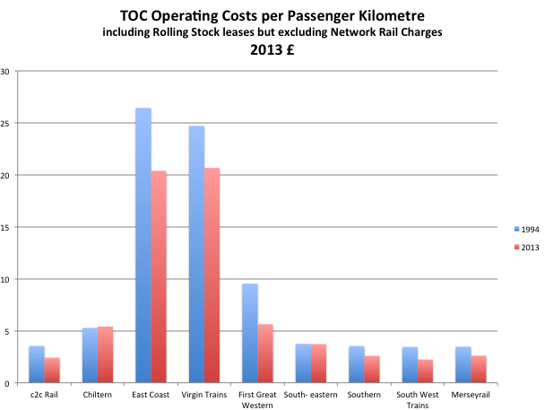
Average costs per passenger km have fallen around 20% since privitisation despite increases in labour and power costs and fleet modernisation
Services are now also more punctual, more reliable and safer
Notes:
Figures are provided for the 9 UK franchises for which comparable data is available. Other franchises have been substantially “remapped”
Figures are real and include rolling stock lease charges
1994 data is derived from audited accounts as provided to franchise bidders
2014 data is from the ORR, the UK independent rail regulator

Slide 16
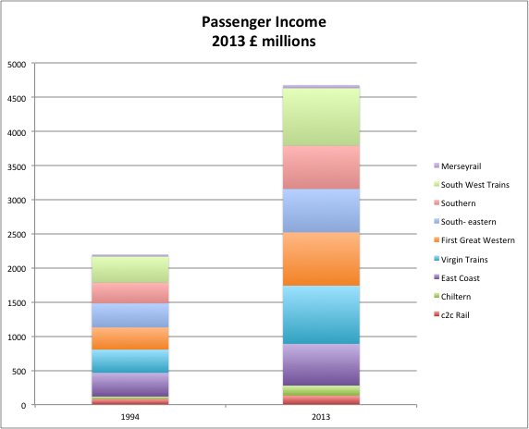
Ridership and revenue have doubled on most routes since 1994. much more than population growth
Average fares have remained constant in real terms, although the range of fares has increased

Slide 17
How has Britain done it?
Smarter pricing (peak and off-peak fares; through fares and integrated ticketing; better retailing)
Competitive service procurement, with both Net Cost (Franchise) and Gross Cost (concession) models – backed by “forensic” analysis of costs, and innovation
Investment – mostly in new rolling stock that is cheaper to operate, and more closely matches markets
Sweden, Australia, Germany, Benelux, other European countries following broadly similar reform paths

Slide 18
Agenda
1
My Background
2
Why Business Planning Matters – UK Experience
3
Toronto GO Expansion
4
Relevance to US Cities

Slide 19
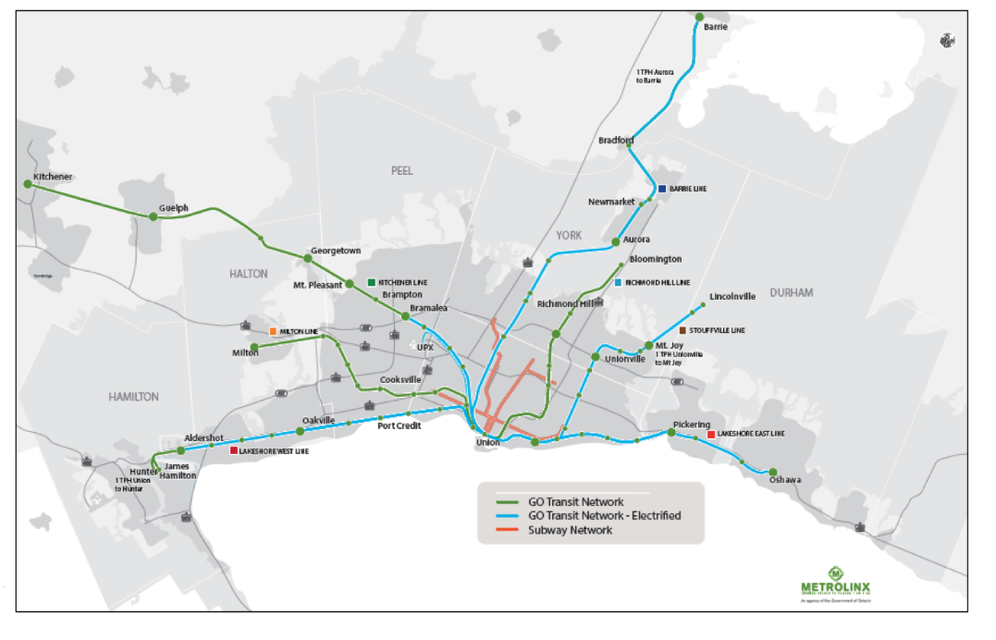
Toronto GO Expansion

Slide 20
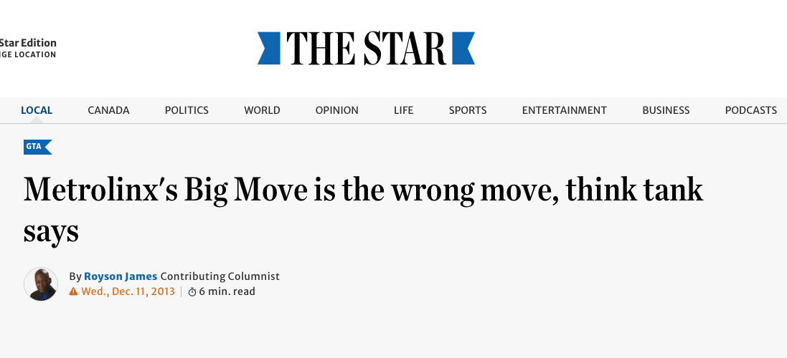
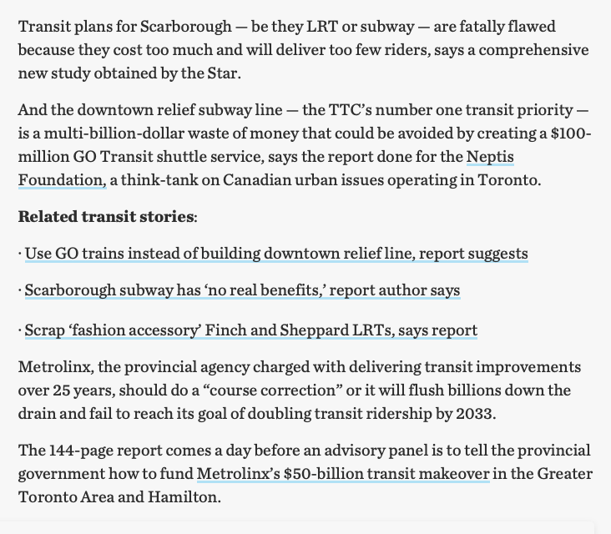

Slide 21
GO RER Chronology
1967 | Experimental service begins on the Lakeshore – as an alternative to freeway widening. Toronto still only has 6 freeway lanes into the CBD. How many in your city?
1980s | GO Service expanded to 7 radial routes; fleet upgraded to 12 car bilevels but remains Peak only services on most routes; hourly service along Lakeshore
2000 | Ridership approaches 100,000 per day. 90% to and from Union; ~80% opex recovery from fares
2008 | Metrolink adopts $14bn program of LRT, BRT, and Subway expansion but GO electrification on “back burner” – not cost effective
2013 | FCP review for Neptis Foundation suggests strong case for GO electrification, when combined with frequent all day service using EMUs. Incremental cost $7bn (above what would otherwise be spent); BCR > 3:1
2014 | GO RER adopted by Ontario Government (as an election issue) and FCP retained to prepare Initial Business Case. Confirms BCR > 3:1 Early works commence
2018 | Full Business Case published. Now $20bn cost including SOGR, new stations with integrated development. BCR remains > 3:1. After electrification is complete, fare revenues will exceed O&M costs by a large margin
2019 | Consortia shortlisted for “OnCorridor” DBFOM contract

Slide 22
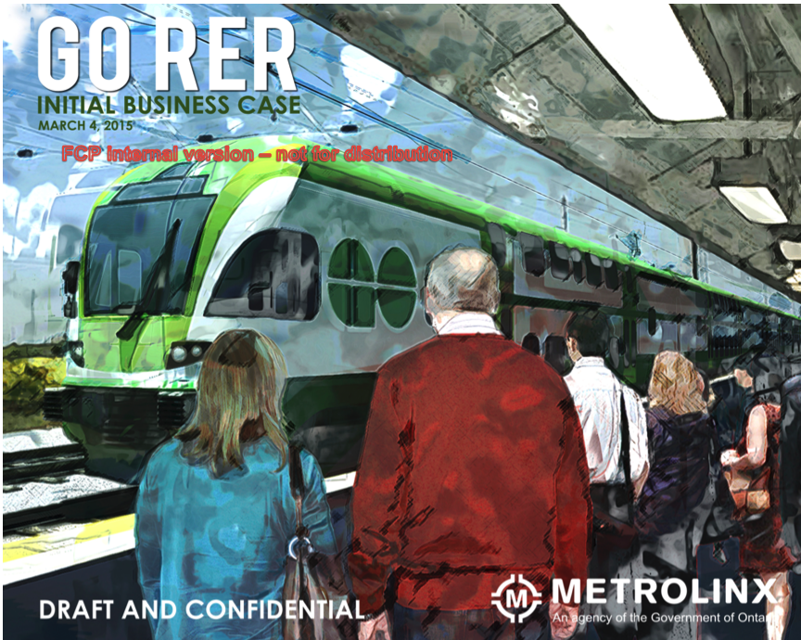

Slide 23
Integrated Business Case model
Inputs
Capital costs
Existing demand and underlying growth (2.3% reflecting historic and projected growth)
Demand elasticities (trip times and frequencies) (0.3% peak, 1% off-peak)
Operating cost rates (calibrated against actual GO costs, and international experience)
Fleet and service strategies
Outputs
O&M costs, revenues, and subsidy or surplus
Benefits (passenger time savings at $18/hour, road user benefits)
Net Benefits and Cost Benefit Ratios
All costs and benefits calculated over 60 years, with 3.5% real discount rate.

Slide 24
4 Service Levels tested on each of 7 corridors
Commuter Rail | As existing (2014) with bi-level diesels Half-hourly all day on Lakeshore Peak only, peak direction on other routes
Two-way all day | Half-hourly all day electric locos on Lakeshore Hourly all day diesel on other routes Requires some double tracking
Diesel RER | Diesel trains every 15 minutes all day on all routes Requires extensive double tracking
Regional Express Rail | All day every 15 minutes with EMUs to “inner” stations All day every 30 minutes with EMUs beyond c20 miles Peak only services use bilevels with electric locos

Slide 25
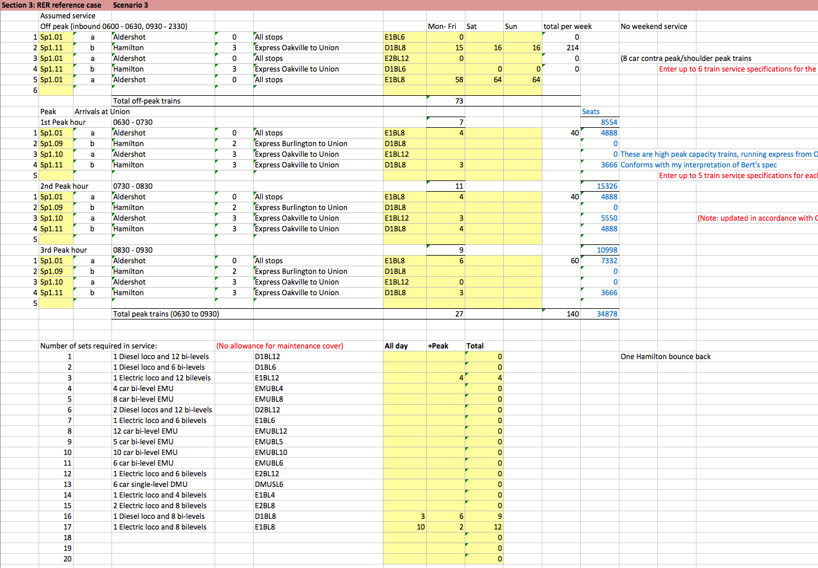
Service plans for 7 corridors and 5 scenarios
example

Slide 26
Capital Expenditure by Corridor

Slide 27
Using EMUs over DMUs and diesel locomotives reduces operating cost, increases revenue and offers additional benefits to operators
Much lower operating costs per train mile – for the lower traffic levels typically attracted off-peak
Faster acceleration and braking which leads to:
    Higher revenues and benefits
    Higher fleet and crew productivity
Lower noise (so noise wall savings??)
Retaining existing bi-level fleet but replacing with electric locos reduces capital costs

Slide 28
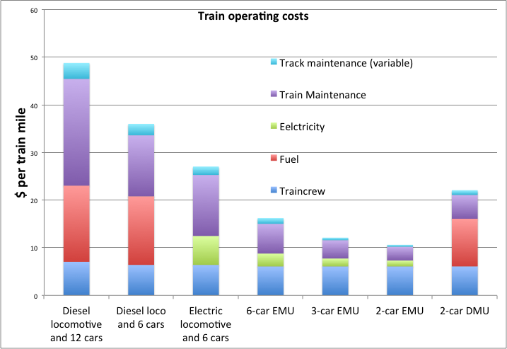
EMUs have significantly lower operating costs than diesel locomotives and DMUs due to a lower cost of traction power and reduced maintenance cost

Slide 29
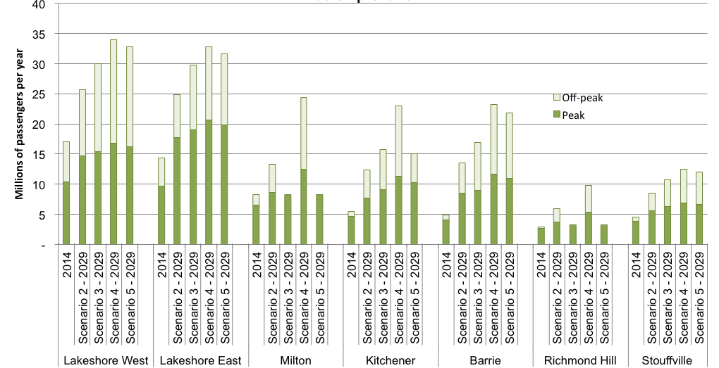
Ridership growth by Corridor

Slide 30
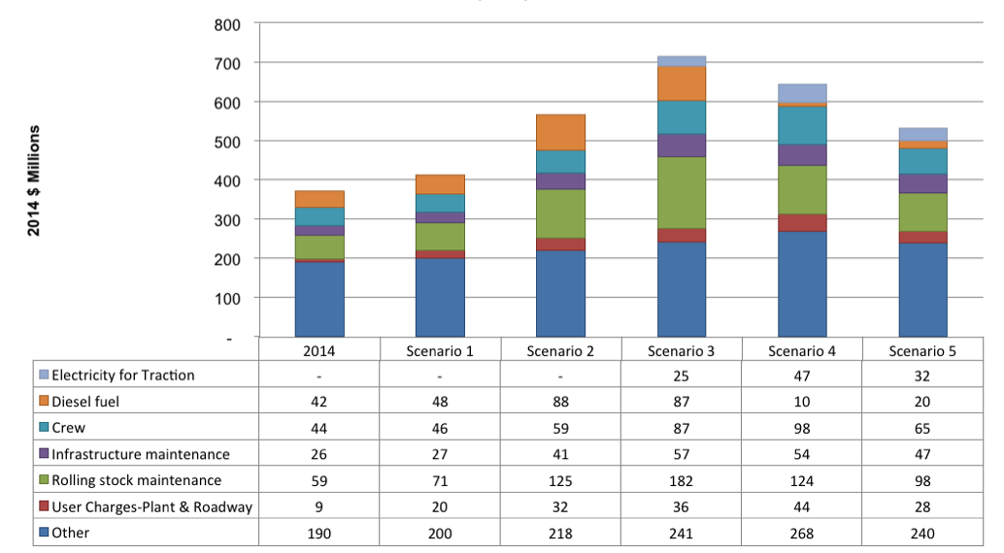
Operating Costs

Slide 31
INCREMENTAL ANALYSIS | Scenario 4 |  |  | compared with Do Minimum
2014 $ millions NPV | Lakeshore West | Lakeshore East | Milton | Kitchener | Barrie | Richmond Hill | Stouffville | Total GO Rail | GO Bus | Total GO
Revenue | 1,531 | 1,229 | 1,801 | 2,158 | 2,263 | 608 | 829 | 10,506 | (288) | 10,218
Crew | (96) | (7) | (169) | (305) | (225) | (140) | (114) | (1,040) | 182 | (859)
Fuel | 121 | 288 | 61 | 80 | 97 | 22 | 36 | 775 | 70 | 845
Electricity for Traction | (107) | (122) | (100) | (150) | (210) | (56) | (60) | (843) | - | (843)
Rolling stock maintenance | (12) | 104 | (158) | (231) | (459) | (94) | (95) | (932) | 35 | (897)
Infrastructure maintenance | (74) | (45) | (82) | (219) | (201) | (70) | (80) | (771) | - | (771)
User Charges-Plant & Roadway | (86) | - | 87 | (352) | - | (62) | - | (413) | - | (413)
Other | (158) | (43) | (159) | (286) | (250) | (114) | (96) | (1,106) | 15 | (1,091)
Operating Costs | (413) | 175 | (519) | (1,462) | (1,248) | (514) | (409) | (4,330) | 301 | (4,029)
Operating Surplus | 1,118 | 1,405 | 1,281 | 696 | 1,015 | 94 | 420 | 6,177 | 13 | 6,189
Infrastructure | (254) | (62) | (1,206) | (2,288) | (1,395) | (814) | (773) | (6,792) | - | (6,792)
Electrification capex | (470) | (425) | (261) | (624) | (524) | (274) | (188) | (2,767) | - | (2,767)
Property | (19) | (36) | (60) | (116) | (77) | (41) | (23) | (372) | - | (372)
Property | - | - | - | - | - | - | - | - | - | -
Parking | (219) | (324) | (360) | (426) | (272) | (166) | (180) | (2,563) | 143 | (2,420)
Other network capex | - | - | - | - | - | - | - | (1,509) | - | (1,509)
Capital Investment | (962) | (848) | (1,888) | (3,453) | (2,267) | (1,295) | (1,164) | (14,001) | 143 | (13,858)
Total Cost | (1,375) | (673) | (2,407) | (4,914) | (3,515) | (1,809) | (1,573) | (18,331) | 444 | (17,887)
Surplus or (subsidy) | 156 | 557 | (606) | (2,756) | (1,252) | (1,201) | (744) | (7,825) | 156 | (7,669)
Existing Transit User Time Savings | 2,675 | 2,573 | 1,075 | 1,256 | 1,186 | 706 | 289 | 9,802 | - | 9,802
New Transit User Time Savings | 1,087 | 718 | 2,154 | 3,228 | 3,458 | 946 | 1,231 | 12,821 | - | 12,821
Peak Period Road User Time Savings | 503 | 606 | 544 | 546 | 801 | 265 | 223 | 3,488 | - | 3,488
Off-Peak Road User Time Savings | 152 | 105 | 175 | 205 | 303 | 60 | 90 | 1,090 | - | 1,090
Auto Operating Cost Reduction | 3,267 | 2,689 | 3,711 | 4,147 | 6,121 | 1,410 | 1,803 | 23,236 | - | 23,236
Safety Benefits | 351 | 288 | 399 | 443 | 653 | 151 | 193 | 2,479 | - | 2,479
TOTAL TRANSPORT BENEFITS | 8,034 | 6,978 | 8,058 | 9,824 | 12,524 | 3,539 | 3,830 | 52,916 | - | 52,916
Road and transit user benefits | 4,767 | 4,289 | 4,347 | 5,677 | 6,402 | 2,129 | 2,027 | 29,681 | - | 29,681
NARROW BENEFIT:COST RATIO | infinite | infinite | 7.17 | 2.06 | 5.11 | 1.77 | 2.72 | 3.79 | infinite | 3.87
Total benefits | 8,034 | 6,978 | 8,058 | 9,824 | 12,524 | 3,539 | 3,830 | 52,916 | - | 52,916
Net benefits | 6,659 | 6,305 | 5,651 | 4,910 | 9,008 | 1,730 | 2,257 | 34,585 | 444 | 35,029
FULL BENEFIT:COST RATIO | 5.84 | 10.38 | 3.35 | 2.00 | 3.56 | 1.96 | 2.44 | 2.89 | infinite | 2.96

Slide 32
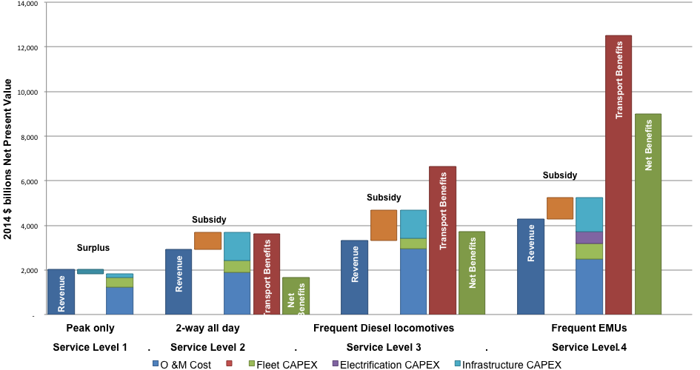
Service Level 4 (frequent EMUs) generate significantly greater transport benefits and net benefits at comparable cost levels
Service Level Modelling

Slide 33
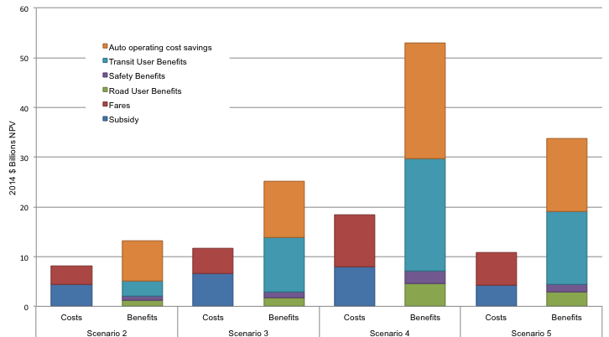
GO RER Incremental Subsidy, Fares and Benefits
GO RER Incremental Subsidy, Fares and Benefits

Slide 34
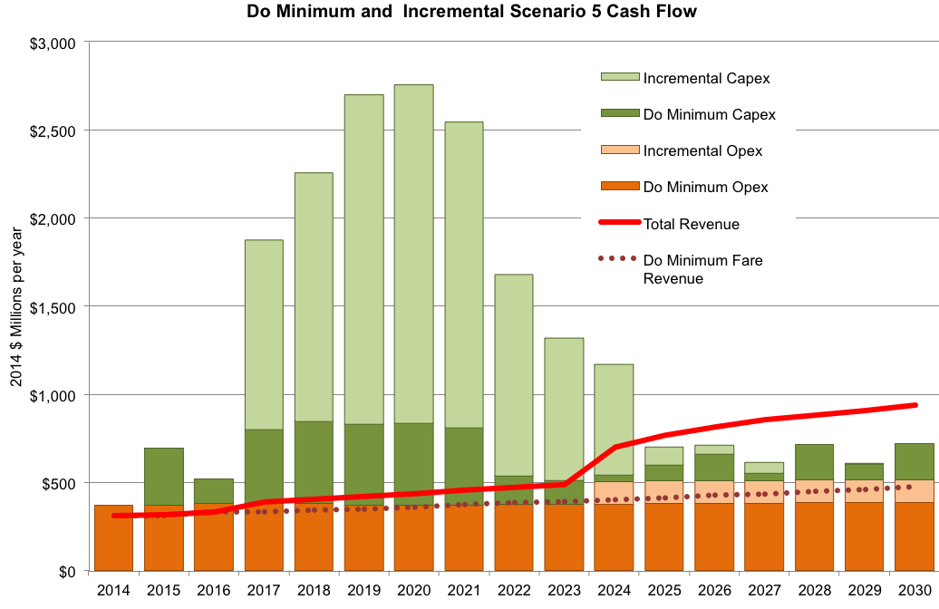
RER will generate operating surpluses that will pay back a substantial share of capital costs

Slide 35
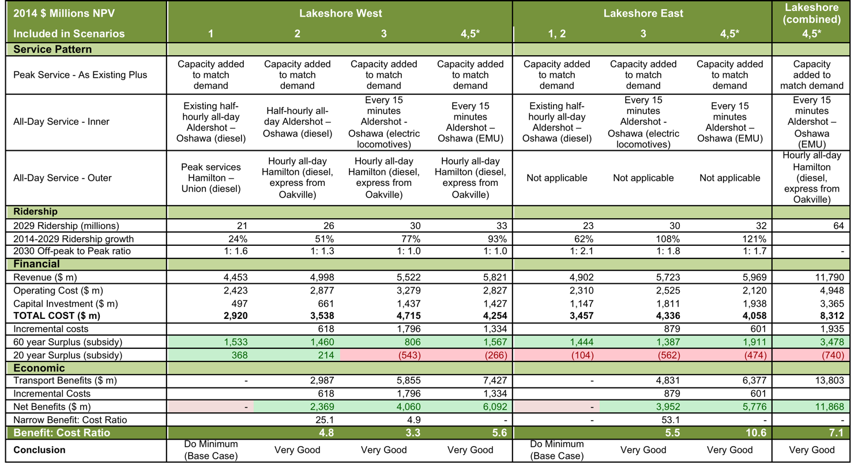
On the Lakeshore, EMUs appear to cost 20% less to operate and attract 6% more revenue. Are we sure?

Slide 36
GO Expansion - Status
New government elected June 2018 reaffirmed support for the project
Early works underway including double tracking of Stouffville and Barrie corridors, rebuilding tunnel under 401 expressway
Decision to split project into “on corridor” and “off corridor” works
On Corridor works, including track, signalling, trains, power, and 30 years operation to be awarded as a single contract. Now ”in market” with international teams preparing bids
Off Corridor works to be implemented through a range of contracts including an “alliance” contract for Union Station
Stations to be rebuilt or built, wherever possible, in partnership with private developers. Several already underway
15 minute all-day service introduced on Lakeshore in 2019; hourly all day services now operating on 3 other corridors all using diesels

Slide 37
Agenda
1
My Background
2
Why Business Planning Matters – UK Experience
3
Toronto GO Expansion
4
Relevance to US Cities

Slide 38
Relevance to US Cities
Several US city-regions have diesel commuter rail systems with infrequent all-day services
Some are even electrified, but use trains optimized for the peak, not the off-peak
Ridership on US commuter rail corridors is typically about half as much as on GO, due to competing freeway capacity. But the numbers can still work
Initial work looking at the MBTA system suggests that the case for RER can still be very strong.

Slide 39
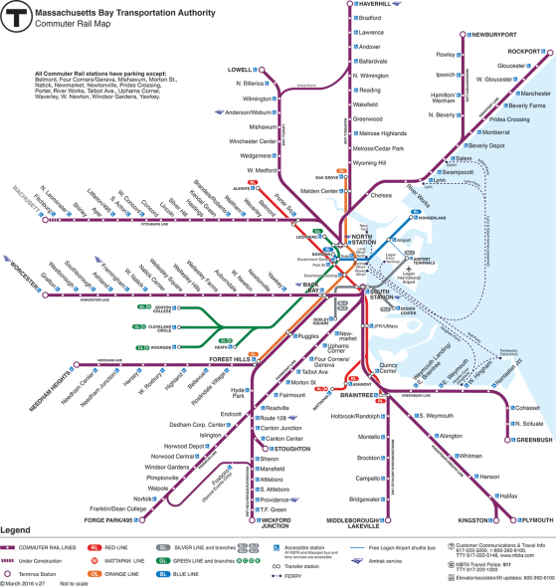
MBTA Commuter Map

Slide 40
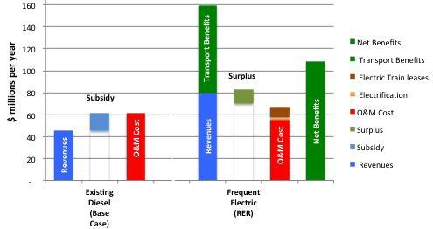
Providence/Stoughton Line – payback is within a few years
The Providence Line is already electrified but MBTA uses diesel trains
The Stoughton Branch can be electrified probably for less than $50m
Farebox recovery rises to 150%, repaying capital costs in a few years

Slide 41
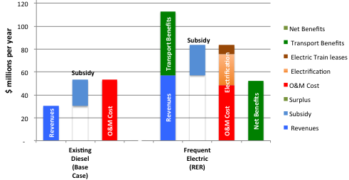
Newburyport/Rockport Lines - Incremental fares can pay back most of the electrification costs
This line has the highest non-peak traffic, which will double with RER
FRR rises to about 120%
The required subsidy increase is about 10% or $4m/year from the current level

Slide 42
Conclusions
With rigorous Business Planning, policy makers can choose between schemes on total cost and benefits – and dollars can be spent where they go further
GO RER / GO Expansion Business Cases available at www.metrolinx.com
Review of the Big Move available at www.neptis.org
The Railway Metropolis available from www.amazon.com

